Slide 1
chapter 10 Unsupervised Learning

Slide 2
This chapter will instead focus on unsupervised learning, a set of statistical tools intended for the setting in which we have only a set of features X1, X2, . . . , Xp measured on n observations. We are not interested in prediction, because we do not have an associated response variable Y . Rather, the goal is to discover interesting things about the measurements on X1, X2, . . . , Xp.
principal components analysis
clustering

Slide 3
10.1 The Challenge of Unsupervised Learning
If we fit a predictive model using a supervised learning technique, then it is possible to check our work by seeing how well our model predicts the response Y on observations not used in fitting the model. However, in unsupervised learning, there is no way to check our work because we don’t know the true answer—the problem is unsupervised。

Slide 4
10.2 Principal Components Analysis
When faced with a large set of correlated variables, principal components allow us to summarize this set with a smaller number of representative variables that collectively explain most of the variability in the original set. PCA is an unsupervised approach, since it involves only a set of features X1, X2, . . . , Xp, and no associated response Y . Apart from producing derived variables for use in supervised learning problems, PCA also serves as a tool for data visualization (visualization of the observations or visualization of the variables).

Slide 5
10.2.1 What Are Principal Components?
Suppose that we wish to visualize n observations with measurements on a set of p features, X1, X2, . . . , Xp, We could do this by examining two-dimensional scatterplots of the data, each of which contains the n observations’ measurements on two of the features. However, there are p(p−1)/2 such scatterplots.

Slide 6
low-dimensional representation
Clearly, a better method is required to visualize the n observations when p is large. In particular, we would like to find a low-dimensional representation of the data that captures as much of the information as possible. For instance, if we can obtain a two-dimensional representation of the data that captures most of the information, then we can plot the observations in this low-dimensional space.

Slide 7

PCA provides a tool to do just this. It finds a low-dimensional representation of a data set that contains as much as possible of the variation.
The idea is that each of the n observations lives in p dimensional space, but not all of these dimensions are equally interesting. PCA seeks a small number of dimensions that are as interesting as possible, where the concept of interesting is measured by the amount that the observations vary along each dimension.

Slide 8
Geometric interpretation for PCA
There is a nice geometric interpretation for the first principal component. The loading vector φ1 with elements φ11, φ21, . . . , φp1 defines a direction in feature space along which the data vary the most.
If we project the n data points x1, . . . , xn onto this direction, the projected values are the principal component scores z11, . . . , zn1 themselves.

Slide 9
Low-dimensional views of the data
Once we have computed the principal components, we can plot them against each other in order to produce low-dimensional views of the data.
For instance, we can plot the score vector Z1 against Z2, Z1 against Z3, Z2 against Z3, and so forth. Geometrically, this amounts to projecting the original data down onto the subspace spanned by φ1, φ2, and φ3, and plotting the projected points.

Slide 10
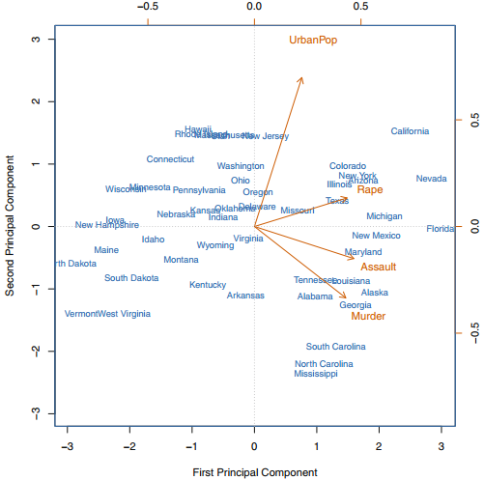

Slide 11
10.2.2 Another Interpretation of Principal Components
Principal components provide low-dimensional linear surfaces that are closest to the observations.
The first principal component loading vector has a very special property: it is the line in p-dimensional space that is closest to the n observations (using average squared Euclidean distance as a measure of closeness). The appeal of this interpretation is clear: we seek a single dimension of the data that lies as close as possible to all of the data points, since such a line will likely provide a good summary of the data.

Slide 12
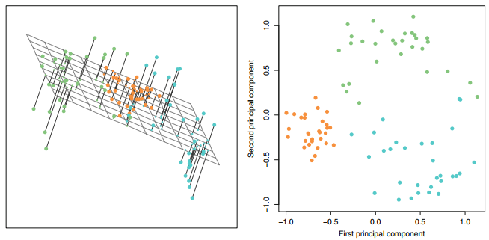

Slide 13
10.2.3 More on PCA
Scaling the Variables
the results obtained when we perform PCA will also depend on whether the variables have been individually scaled (each multiplied by a different constant).
Uniqueness of the Principal Components This means that two different software packages will yield the same principal component loading vectors, although the signs of those loading vectors may differ.

Slide 14
The Proportion of Variance Explained
We can now ask a natural question: how much of the information in a given data set is lost by projecting the observations onto the first few principal components? That is, how much of the variance in the data is not contained in the first few principal components?
Deciding How Many Principal Components to Use In fact, we would like to use the smallest number of principal components required to get a good understanding of the data. How many principal components are needed? Unfortunately, there is no single (or simple!) answer to this question.

Slide 15
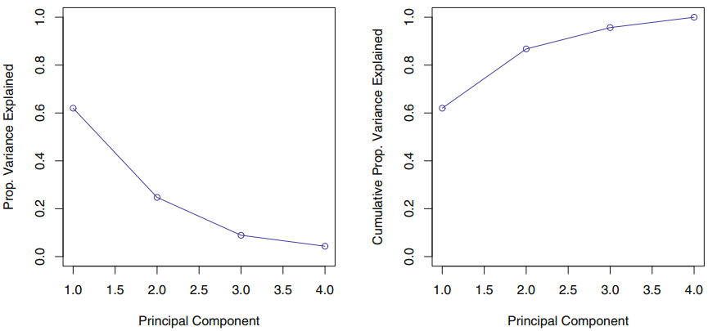

Slide 16
10.3 Clustering Methods
Clustering refers to a very broad set of techniques for finding subgroups, or clusters, in a data set. When we cluster the observations of a data set, we seek to partition them into distinct groups so that the observations within each group are quite similar to each other, while observations in different groups are quite different from each other.
K-means clustering
Hierarchical clustering

Slide 17


10.3.1 K-Means Clustering
1. C1 ∪ C2 ∪ . . . ∪ CK = {1, . . . , n}. In other words, each observation belongs to at least one of the K clusters. 2. Ck ∩ Ck’ = ∅ for all k ≠ k’. In other words, the clusters are nonoverlapping: no observation belongs to more than one cluster.

Slide 18
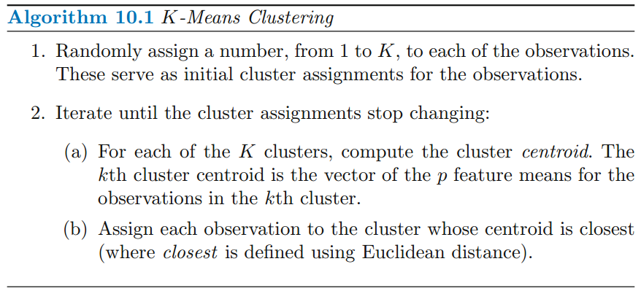

Slide 19
Code : Principal Components Analysis
library(ISLR)
states =row.names ( USArrests )
states
names ( USArrests )
apply ( USArrests , 2, mean )
apply ( USArrests , 2, var )
pr.out = prcomp ( USArrests , scale =TRUE)
names (pr.out )
pr.out$center
pr.out$scale
pr.out$rotation
dim (pr.out$x )
biplot (pr.out , scale =0)
pr.out$sdev

Slide 20
Code : K-Means Clustering
set.seed (2)
x= matrix ( rnorm (50*2) , ncol =2)
x [1:25 ,1]= x [1:25 ,1]+3
x [1:25 ,2]= x[1:25 ,2] -4
km.out =kmeans (x,2, nstart =20)
km.out

Slide 21
Code : Hierarchical Clustering
hc.complete = hclust (dist(x), method ="complete")
hc.average = hclust ( dist(x), method ="average")
hc.single =hclust (dist(x), method ="single")
par ( mfrow =c(1 ,3) )
plot(hc.complete ,main =" Complete Linkage ", xlab ="", sub ="",cex =.9)
plot(hc.average , main =" Average Linkage ", xlab ="", sub ="",cex =.9)
plot(hc.single , main =" Single Linkage ", xlab ="", sub ="",cex =.9)

